Slide 1
Overleaf Typesetting Workshop
Hosted by the 2022 Spring Student Research Symposium
Organized by the Geospatial Computer Science Graduate Student Organization (GSCGSO)
Sponsored by Overleaf kinda*

Slide 2
Workshop Instructors
Efrén López Morales GSCS Ph.D. Student
Ahmed Saad GSCS Ph.D. Student

Slide 3
Show of hands
Did you know about Overleaf before this workshop?
Have you ever used LaTeX or Overleaf to write a document, any document?

Slide 4
Overleaf and Chill Chillax TGI Friday Etc.
Before we begin

Slide 5
Agenda
Introduction to Overleaf (15 min)
What is Overleaf?
Talk a little bit about LaTeX
Talk about comparison between Word and Overleaf (table)
Benefits of Overleaf over Word and other LaTex editors (table)
Create Overleaf account (activity) (5-8 min)
Overleaf GUI (10-12 min)
Projects
Editor, source code and file panels
Manage emails
Menu option (top left)
Import Project from local drive (10 min)
Play around with Abstract Project

Slide 6
Agenda
Show them how to look for and open an Overleaf Template.
Give them some time for them look for templates they like.
Collaboration and Sharing (15 min)
Show them how sharing and live commenting works
Creating and responding to comments
Ask them to share their project with one friend or the person next to them. (5-8min)
Tables
Talk about tables and how to create them manually
Talk about Table Generator alternatives
LaTeXdiff
Pandoc
Diagrams.net

Slide 7
Goal of the Workshop
We want to share with you all the tools that we believe are essential to anyone who wants to do research, write and publish their work.
We want you to leave the Workshop feeling like you now have a big toolbox that you can use to make your life easier (academic life)

Slide 8
Introduction
What is Overleaf?
An Online LaTeX Editor
What is LaTeX?
Document Preparation System.
Write DOCUMENTS (Assignments, research papers, etc...)
We will focus on Overleaf not LaTeX in this Workshop

Slide 9
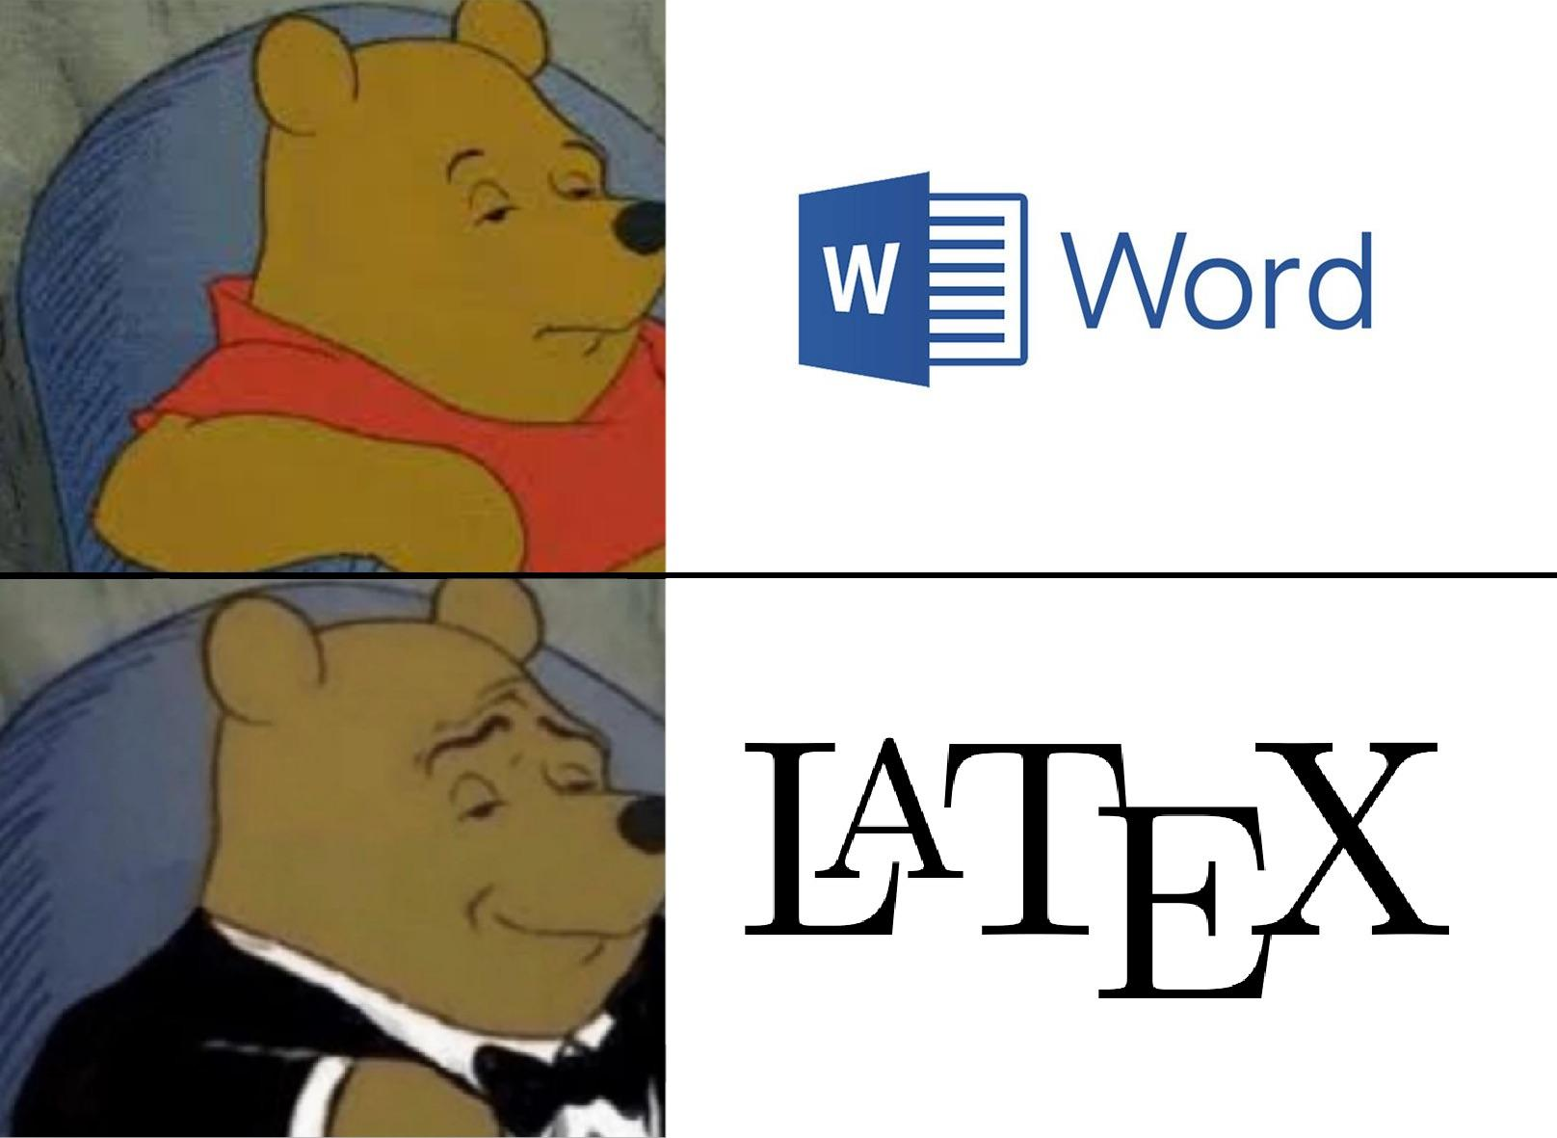

Slide 10
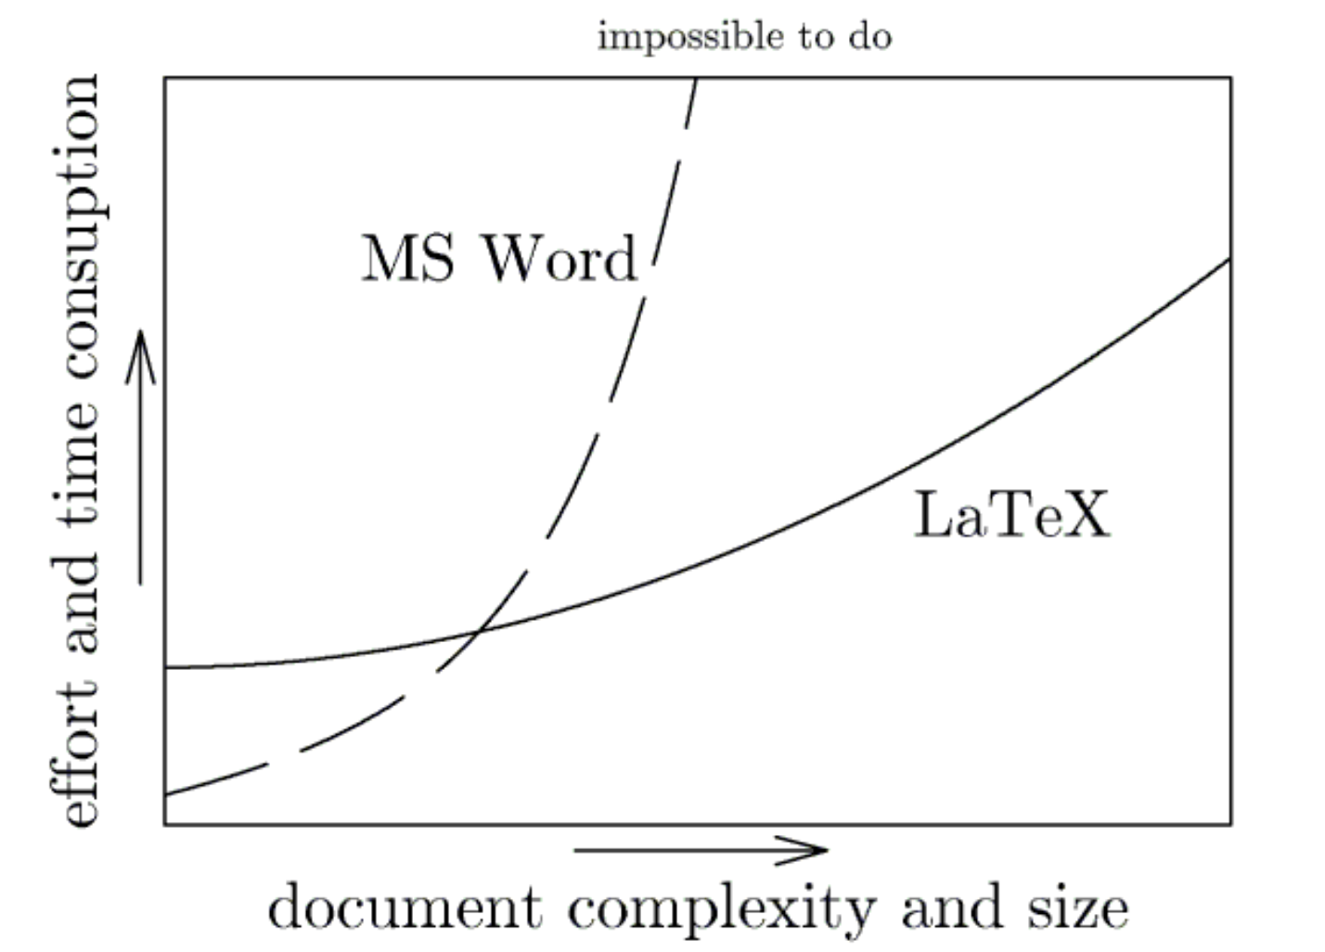
Introduction
Why NOT use MS Word then?
Adheres to a specific formatting

Slide 11
Introduction
Why Overleaf over other LaTeX editors?
Online collaboration tools
User friendly interface
Version control (restore old versions of your Documents)
Very GOOD Documentation (Import images,…...)
Built-in Templates (Thesis, Papers, etc...)

Slide 12
Let's create your account!
If you don’t have an account, we will now help you create one.
If you do have one just sit tight and relax.
https://www.overleaf.com

Slide 13
GUI Walkthrough
Let's Explore
Projects
Preview, source code and file panels
History (Version Control)
Play around with GUI for 5 min

Slide 14
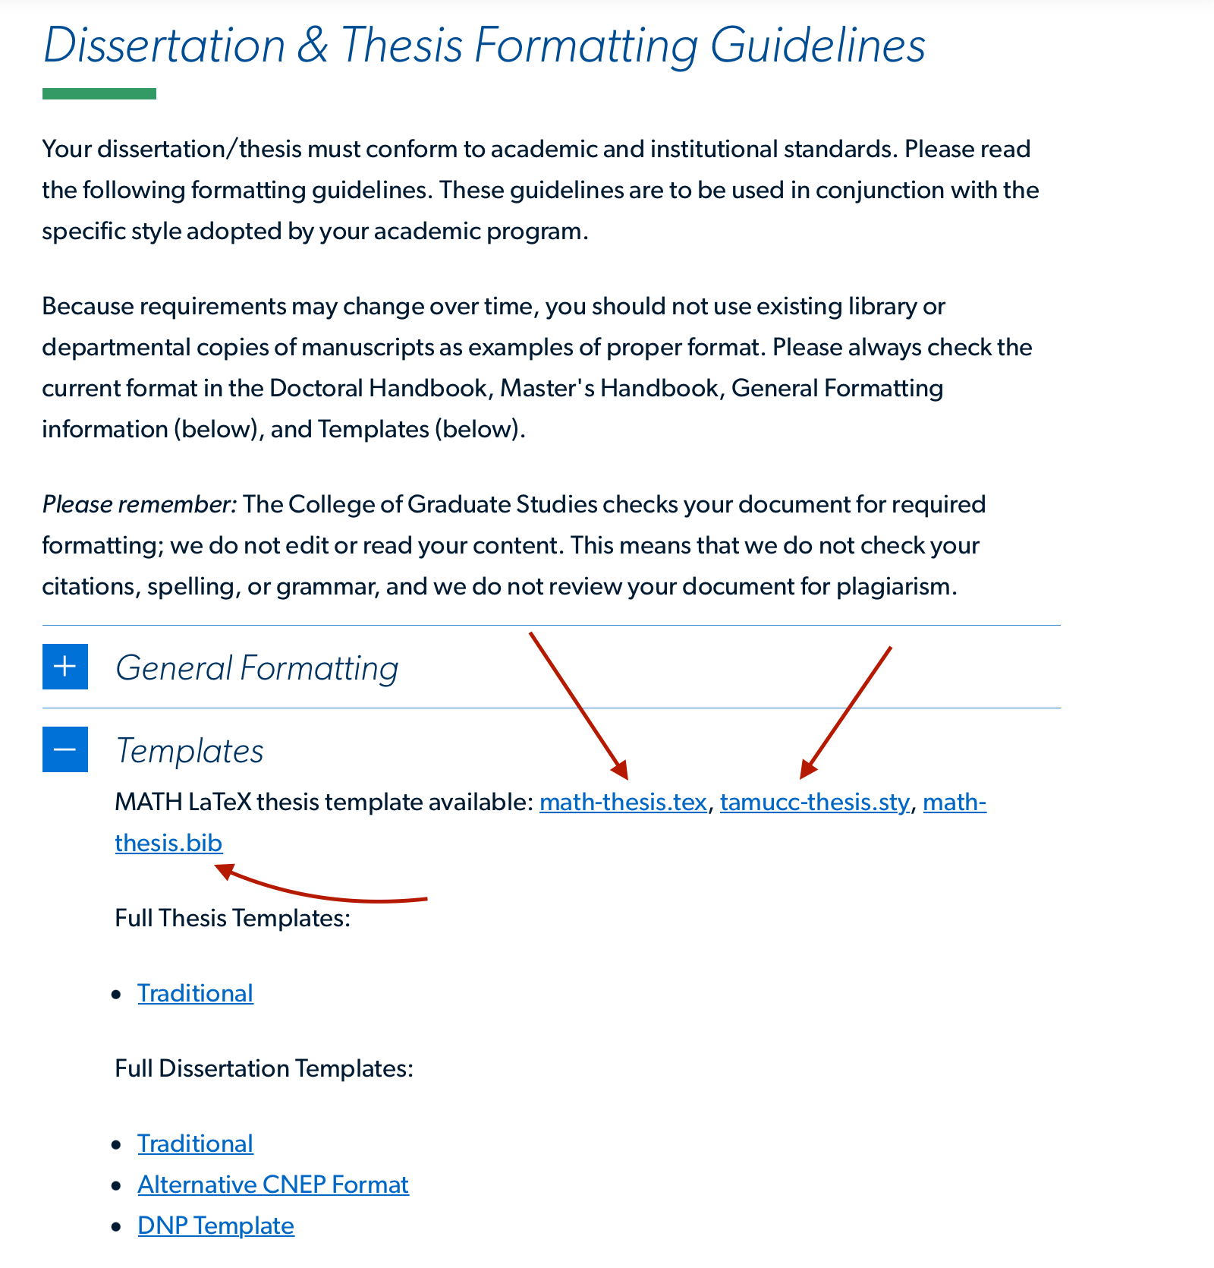
Import Project
Go to "Google.com"
Then Type "TAMUCC Thesis Template"
Go to First Page

Slide 15
Overleaf Templates
Thousands of free Templates ready to use
Journals, CVs, Resumes, Thesis, etc.
Let's try it!

Slide 16
Let's try a template!
Go to https://www.overleaf.com/latex/templates
Take 5 minutes to browse the catalog
Select any template you like.
Click "Open as Template"
Edit!

Slide 17
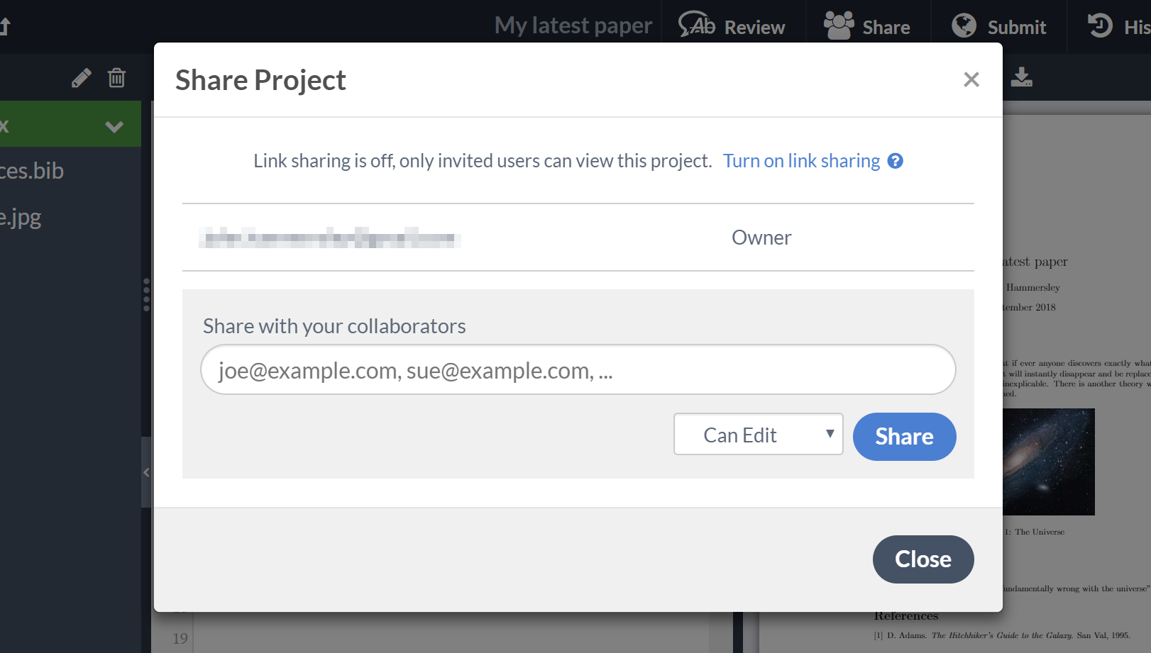
Overleaf Collaboration 101
Project Sharing
Commenting
Chat

Slide 18
Let's try collaborating!
Open the Project that you created from the previous Template
Click Share in the top left
Share your document with the person next to you or with a nice friend
Play around with the comments and make some changes.
Take 5 minutes

Slide 19
Tables in LaTeX

Slide 20
How can you create a table?
Manually (Good luck!)
Table generator (Not to be confused with meme generator)
Table Converter

Slide 21
How to create a table manually

Slide 22
How to use Table Converter
Goto https://tableconvert.com/
Create a simple Excel with a simple table
Convert it to LaTeX
Copy and paste the LaTeX code in your Template

Slide 23
How to use Table Generator
Goto https://www.latex-tables.com/
Create a simple table
Click "Generate"
Copy and paste the LaTeX code in your Template

Slide 24
What is texdiff?
Marking changes to LaTeX documents
Command line interface :(
Free :)
More information:
https://ctan.mirrors.hoobly.com/support/latexdiff/doc/latexdiff-man.pdf

Slide 25
Why would I ever need to use texdiff?
Sometimes journals and conferences will request revisions before publication.
They want to see what changes you made in a nice easy to read PDF
You don't want to mark the changes manually trust me

Slide 26
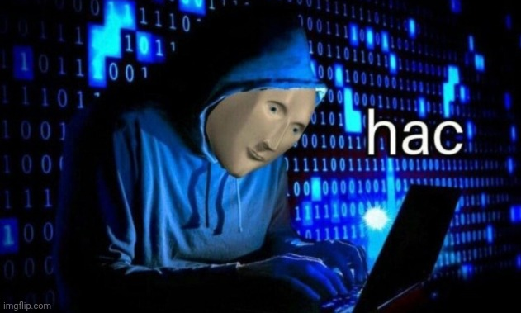
Live Demo
latexdiff draft.tex revision.tex > diff.tex

Slide 27
What is pandoc?
Convert files from one markup format into another
Pandoc is your swiss-army knife.
Click me!
More information:
https://pandoc.org/

Slide 28
Live Demo Convert LaTeX to Word
pandoc main-new.tex -o main-new.docx

Slide 29
What is diagrams.net?
Create amazing diagrams online
Export to PDF, JPEG, PNG, etc.
Free :), no adds, no annoying prompts.
Desktop app
https://www.diagrams.net/

Slide 30
Show of hands
Give us a grade from 1 to 5
With 1 being this workshop sucked :( and 5 being this workshop ruled :)

Slide 31
Live survey
What did you like?
What did you not like?

